Slide 1
Secure code review
Name : Siddhart shah

Slide 2
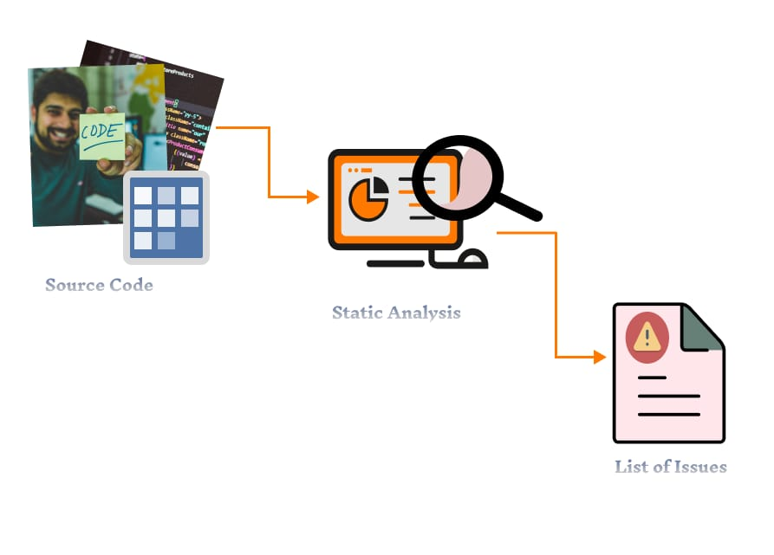
Static Code Analysis Tools
Source Code Analysis Tools, also known as Static application security testing (SAST) Tools. It can helps analyse source code or complied versions of code to help find security flaws.
SAST Tools can be added into your IDE. Such as tools can help you to detect issues during software development.
SAST Tool feedback can save time and effort, especially when compare to finding vulnerabilities later in the development cycle.

Slide 3
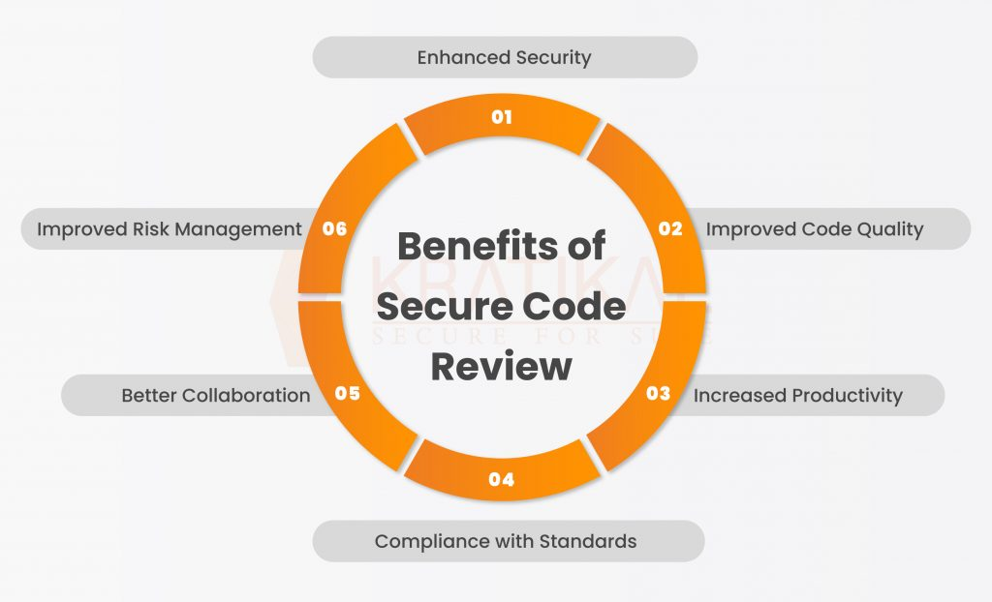
What is secure coding review ?
Secure code review is a manual or automated process that examines an application’s source code.
The goal of this examination is to identify any existing security flaws or vulnerabilities.
Code review specifically looks for logic errors, examines spec implementation, and checks style guidelines, among other activities.

Slide 4
Strengths And Weaknesses
Strengths : Identifies vulnerabilities such as buffer overflows , SQL injection flaws
As SAST Tools highlight the problematic code, by filename, location, line number, and even the affected code snippet.
Weaknesses : difficult to automate searches for many types of security vulnerabilities.
Analysts frequently cannot compile code unless they have : correct libraries, compilation instructions, all required code.

Slide 5
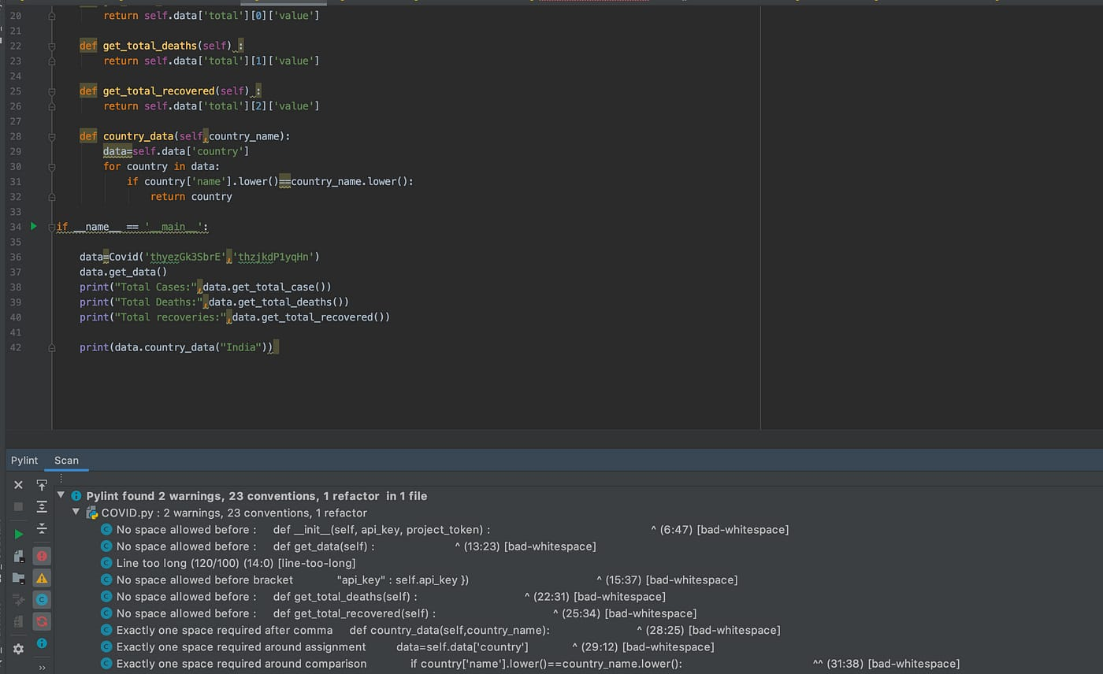
Secure code tools
Pylint : An open source that is widely used in the python community, pylint is highly configurable so you can customize your pre-commit checks

Slide 6
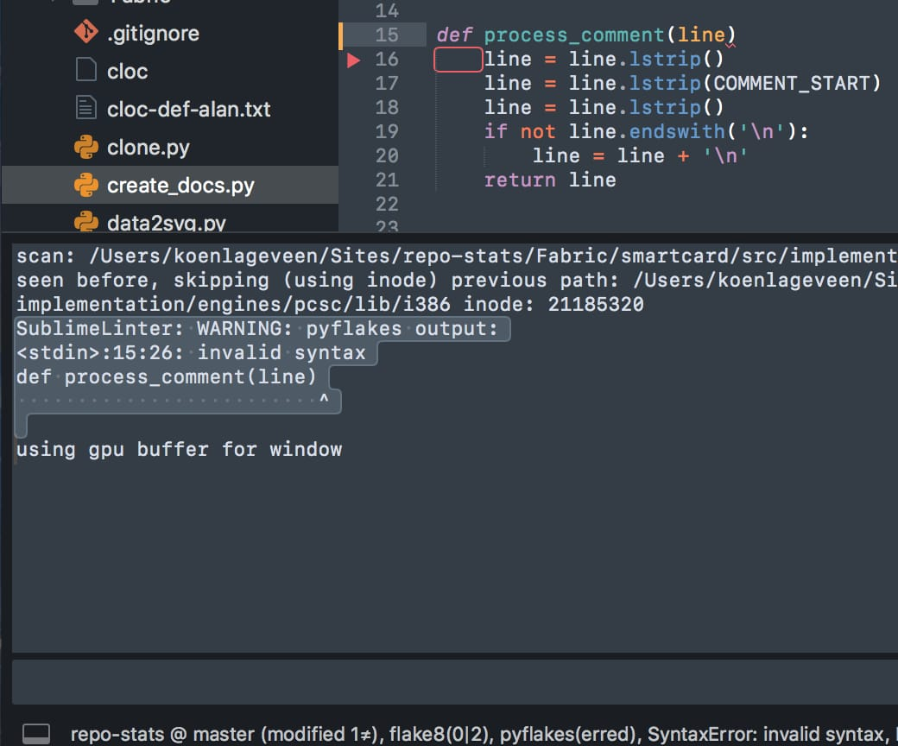
Secure code toos
Pyflakes : Pyflakes is a lightweight static analysis tool focused on identifying error in python code. Its fast and efficient, providing quick feedback during development.

Slide 7
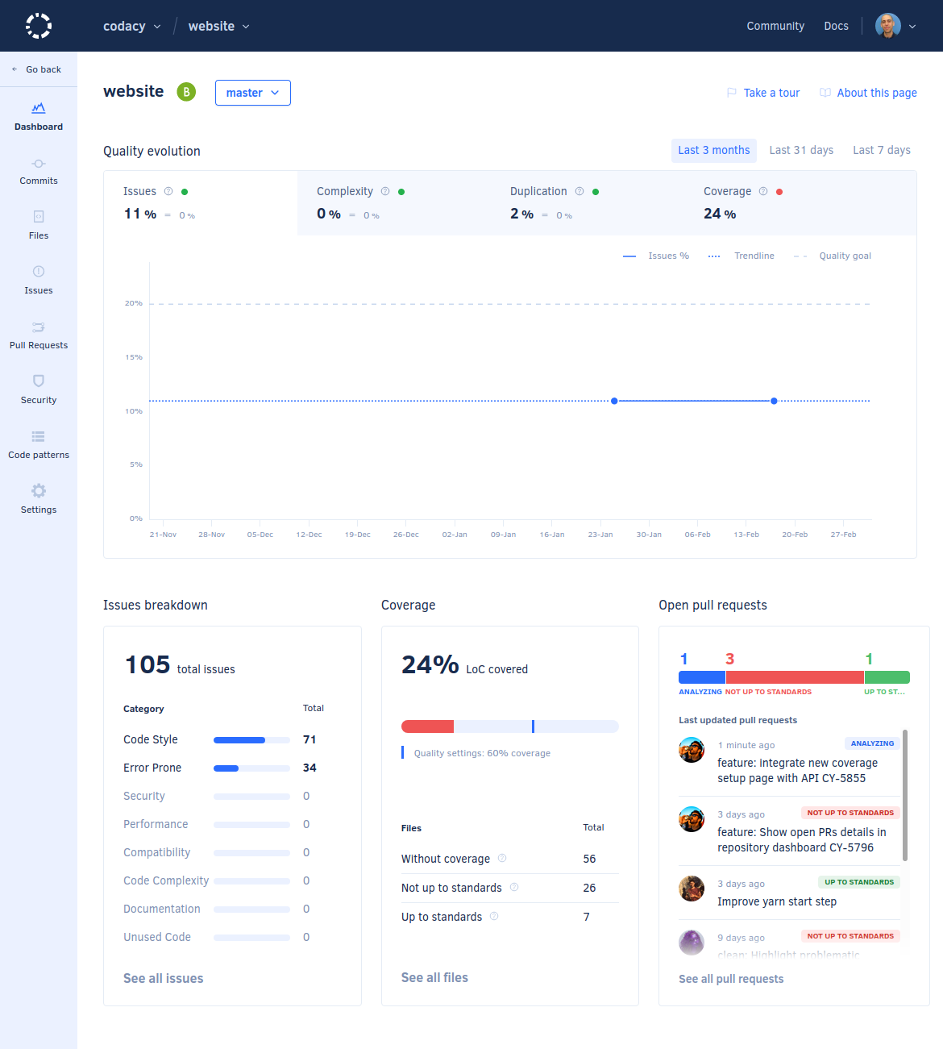
Secure code tools
Codacy : Codacy is automated code review tool that works with python ( more than 40) codacy cover a wide variety of issues like code coverage, duplication, complexity, and more.

Slide 8
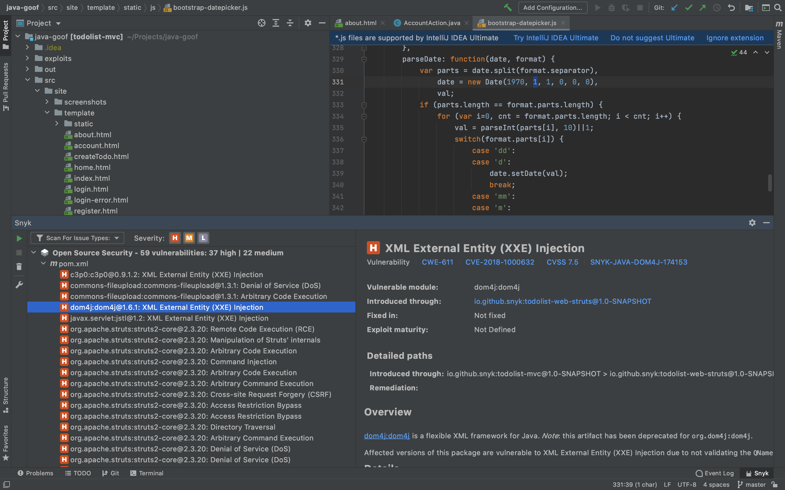
Secure code tools
Snyk Code : Snyk Code is a static analysis tool that uncover vulnerabilities within code before it goes into production, ensuring that the code reviewing is secure.

Slide 9
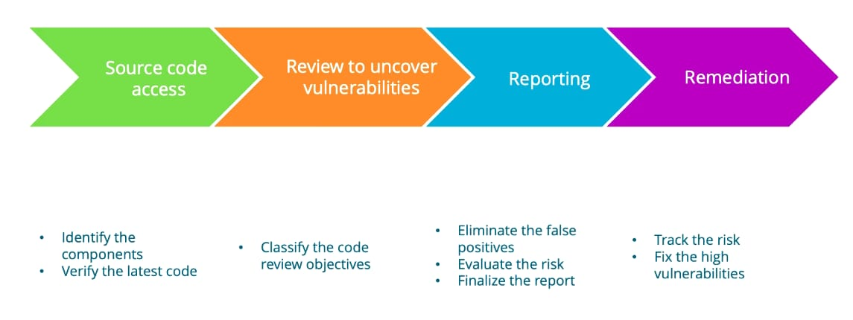
Secure code practices
Input validation : ensuring that all user input are validated and sanitized to prevent common security vulnerabilities such as SQL injection and cross-site
Secure coding practices : Using secure coding guideline and best practices to write code that is less susceptible to security vulnerabilities.
Authentication and authorization : Implementing strong Authentication and authorization mechanisms to control access to sensitive data and function.

Slide 10
Secure code practices
Secure configuration : Ensuring that all software and systems are properly configured and hardened to minimize security risks.
Secure communication : Encrypting sensitive data n transit and using secure communication protocols to protect against eavesdropping and tampering.
Error handling : Implementing proper error handling and logging to prevent the exposure of sensitive information through error message.
Data Encryption : Encrypt sensitive data both at rest and in transit using strong encryption algorithms. Utilize secure encryption libraries and protocols to protect data from unauthorized access.

Slide 11
Thank you

